Slide 1
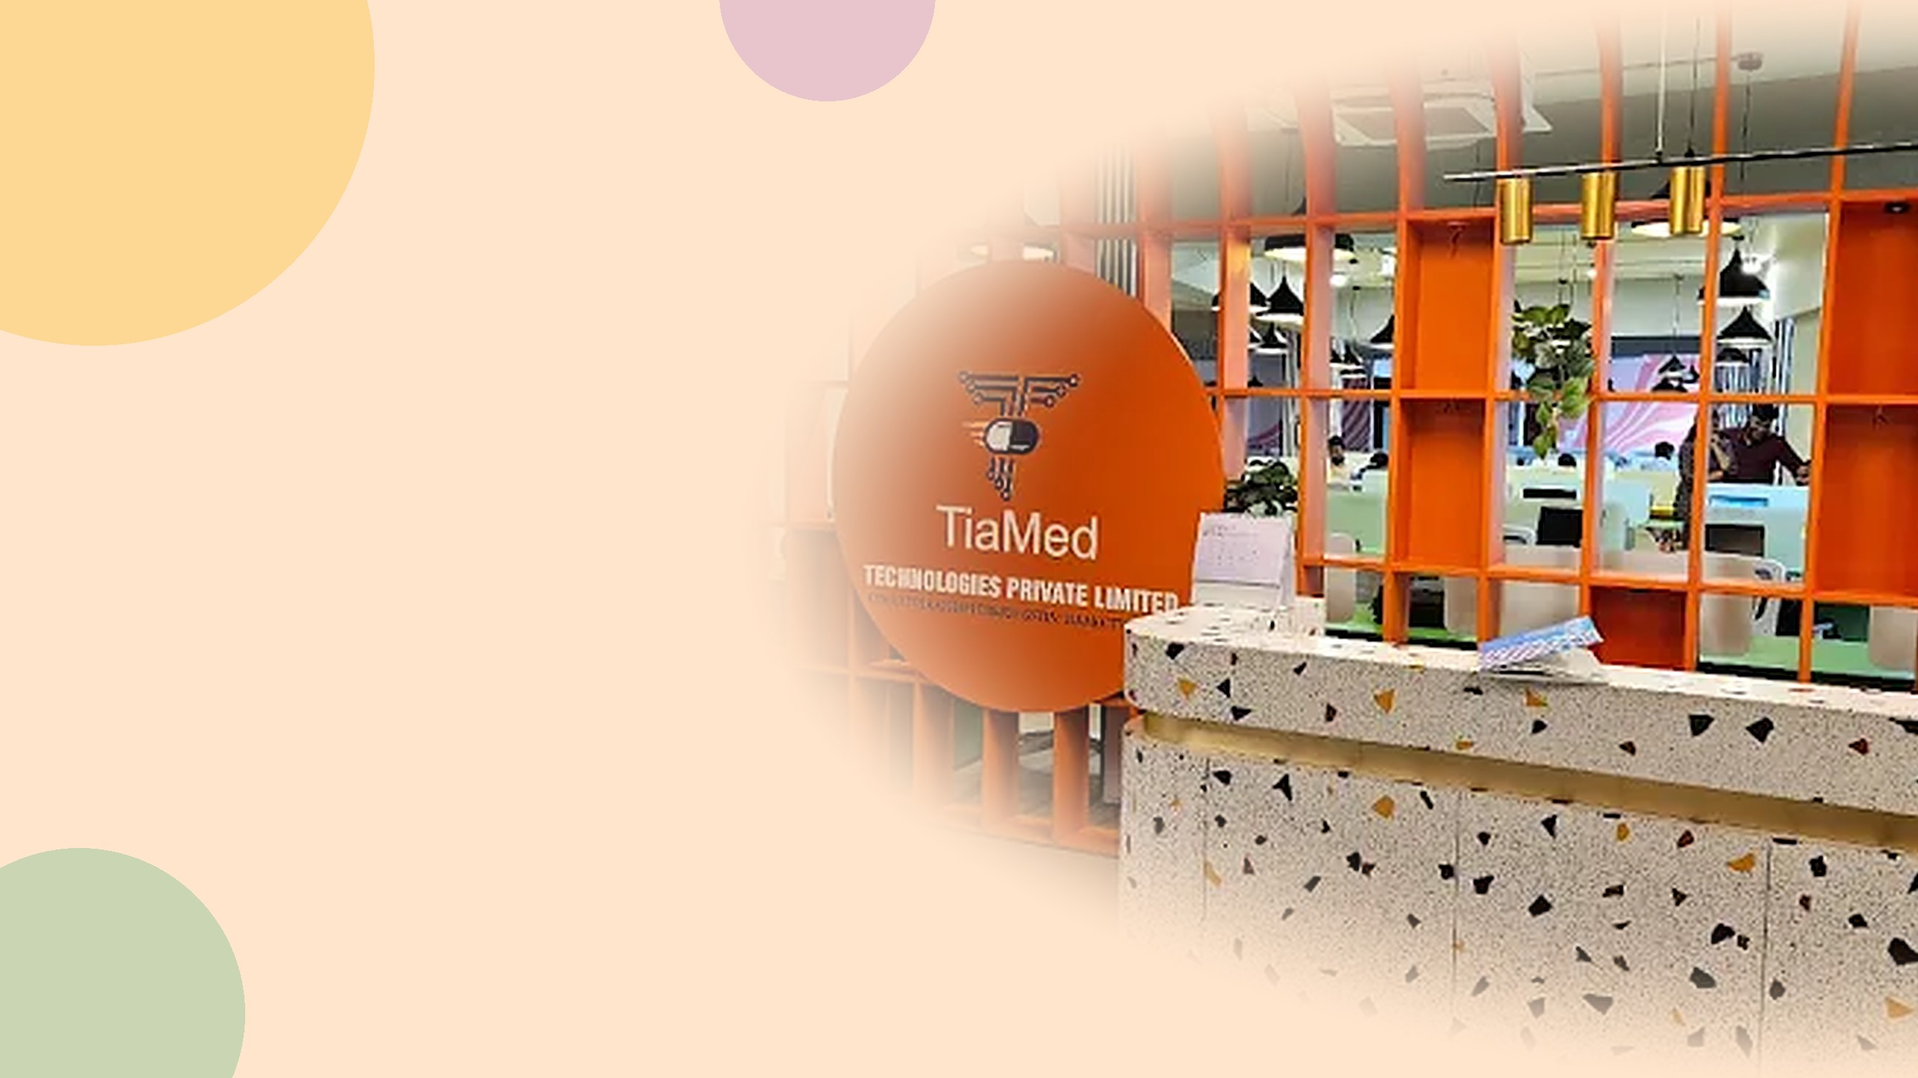
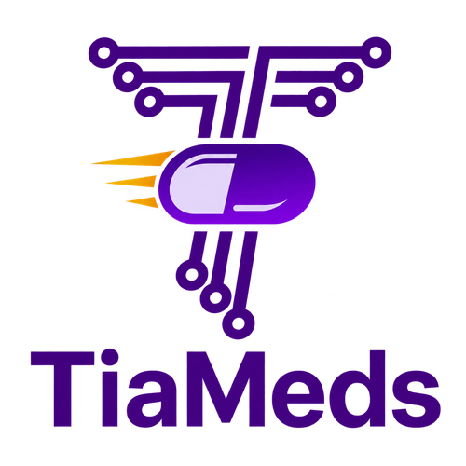








TIAMEDS
TECHNOLOGIES
Building the Digital Infrastructure of Tomorrow
Healthcare
Pharma
IT
Security
Analytics

Slide 2






WHO WE ARE
Corporate Profile
COMPANY
DIRECTORS
LOCATION
TiaMeds Technologies Pvt. Ltd.
Dr. Arjun Sachidanand & Dr. Sini Arjun
Mysuru, Karnataka
WEBSITE
INCORPORATED
EMAIL
www.tiameds.ai
16 February 2024
support@tiameds.ai
TiaMeds Technologies Pvt. Ltd.
2

Slide 3




FOUNDATION
Company Overview
Core Focus
Transforming healthcare through AI-powered, secure and scalable technology that improves operational efficiency and patient outcomes.
Innovative SaaS
Purpose-built digital solutions for Hospitals • Pharmacies • Wellness.
Established & Incorporated
Connected Workflows
Integrating healthcare, pharmacies and Wellness operations through intelligent digital workflows.
Healthcare & pharmaceutical technology company based in Mysuru, Karnataka
Strategic Objective
Building an integrated AI-powered healthcare ecosystem.
TiaMeds Technologies Pvt. Ltd.
3

Slide 4




ECOSYSTEM
AI-Powered Digital Enterprise-Grade Ecosystem
One technology layer connecting India’s healthcare and Pharma Industries
Hospitals
Pharmacies
Wellness
TIAMEDS TECHNOLOGIES
Digital & AI Technology Layer
TiaMeds (Pharma)
Marketplace
TiaMeds One
TiaMeds Technologies Pvt. Ltd.
4

Slide 5


HOSPITALS
AI-Enabled Digital Solutions for Smarter, Connected Hospitals
TiaMeds integrates hospital, laboratory and patient-support workflows through secure, connected and AI-enabled digital solutions.
Time Frame :
Time Frame :
Time Frame :
HIMS
Lab Management
Blood Buddy
AI-Enabled Hospital
Information Management System
AI-Enabled Laboratory Workflow
& Information Management
AI-Enabled Blood Requirement
& Blood-Bank Connectivity
Patient Registration & EMR
Digital Test Ordering & Sample Reg.
Digital Blood Requirement Registration
OPD • IPD • Appointment Mgmt
Automated Sample Tracking
Blood-Bank Availability Search
Doctor & Nursing Workflows
Real-Time Result Management
Intelligent Blood-Bank Matching
Pharmacy & Inventory Integration
Equipment & System Integration
WhatsApp Notifications & Alerts
Billing • Insurance • Claims
Doctor / Patient Report Access
Blood-Bank Details & Location Sharing
AI-Assisted Clinical Insights
AI-Assisted Result & Trend Analysis
Real-Time Patient & Attendant Support
AI-Powered Reports & Dashboards
Quality & Regulatory Compliance
AI-Assisted Prioritisation & Routing
“One Intelligent Digital Ecosystem for Every Hospital Need.”
HIMS + Lab Management + Blood Buddy — unified by an AI & Data Intelligence layer for better coordination, faster workflows and an improved patient experience.
TiaMeds Technologies Pvt. Ltd.
22

Slide 6

PHARMACIES
AI-Enabled Digital Solutions for Smarter Pharmacy Operations
TiaMeds connects pharmacy inventory, procurement and pharmaceutical supply chains through an integrated digital ecosystem.
Time Frame :
Time Frame :
Pharma Inventory
Pharma Marketplace
AI-Enabled Pharmacy Inventory Management
Connected B2B Pharma Procurement Platform
Real-Time Stock Management
Buyer & Supplier Connectivity
Batch & Expiry Tracking
Product Catalogue & SKU Management
Purchase & Sales Management
RFQ & Price Comparison
Billing & Inventory Integration
Digital Order Management
Fulfilment & Returns
AI-Assisted Re-order & Stock Intelligence
Intelligent Procurement & Supplier Insights
Analytics & Management Insights
Inventory Integration
“From Pharmacy Inventory to Intelligent Pharma Procurement.”
Pharma Inventory + Pharma Marketplace — connected by AI & data intelligence for smart procurement, optimized inventory and a connected supply chain.
TiaMeds Technologies Pvt. Ltd.
23

Slide 7
WELLNESS
ARC Sports Zone — Integrated Sports, Fitness & Wellness Ecosystem
Sports, fitness, recreation and wellness activities brought together through physical facilities supported by a digital booking platform.
MULTI-SPORT DESTINATION
LIVE · BOOKING APP
Sports Zone
ARC Sports Zone App
Multi-Sport & Active Lifestyle Destination
Basic Slot Booking App — Already Developed
Indoor & Outdoor Sports Facilities
View Available Sports / Facilities
Fitness & Training Programs
Check Available Time Slots
Sports Coaching & Skill Development
Slot Booking
Recreational & Community Activities
Booking Confirmation
Tournaments & Sporting Events
Basic User & Booking Management
Youth & Grassroots Sports Development
Membership, Facility & Performance Mgmt.
Roadmap: Basic Booking App → Enhanced Digital Platform → Integrated Sports & Wellness Ecosystem
“Play. Perform. Connect. Live Well.”
From a basic slot-booking app today to a fully integrated sports, fitness and wellness ecosystem for the community.
TiaMeds Technologies Pvt. Ltd.
24

Slide 8
ROADMAP
“Product Release Roadmap”
Phased delivery across the TiaMeds platform, module by module
🏥 HOSPITALS
🏥 HOSPITALS
💊 PHARMACIES
💊 PHARMACIES
LIVE
📋
📦
🏪
🧪
HIMS
Pharma Inventory
Pharma Marketplace
Lab Module
🚀
One platform, released in phases — each module strengthens the next.
TiaMeds Technologies Pvt. Ltd.

Slide 9
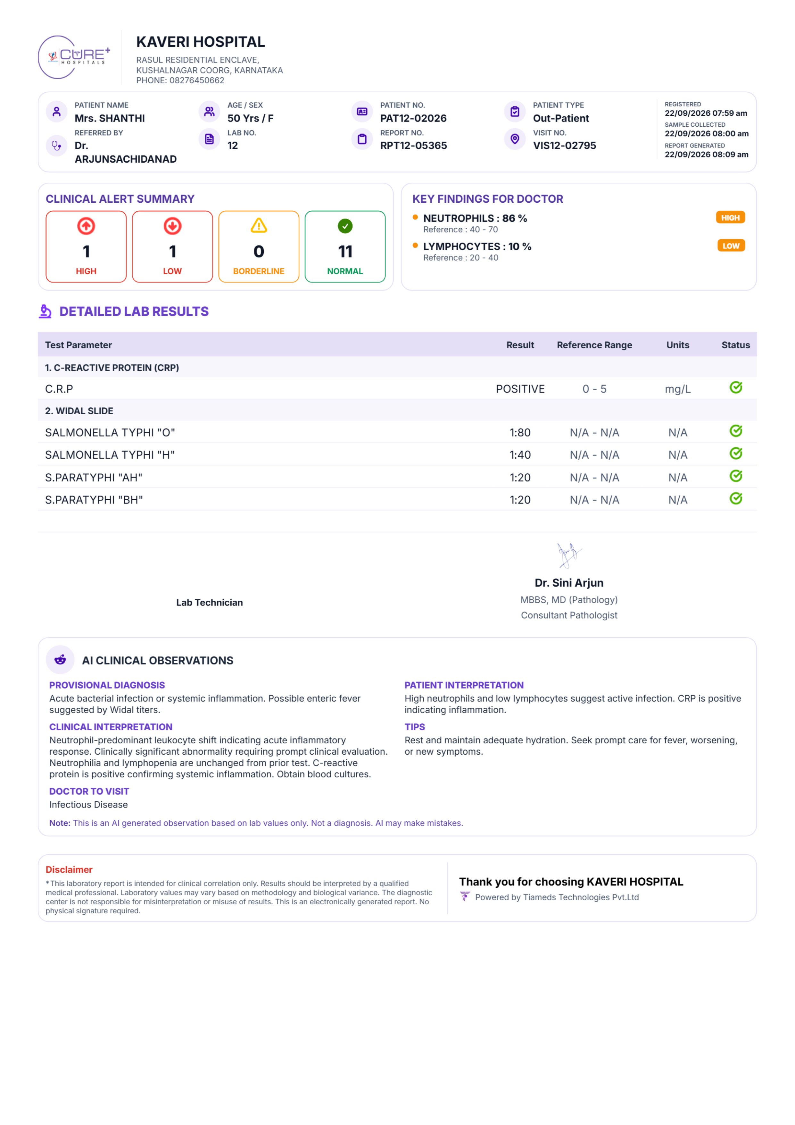
LAB MODULE
TiaMeds Lab Module — AI-Enabled Diagnostic Reporting
TiaMeds turns every lab report into a structured, AI-assisted clinical insight for doctors and patients alike.
ACTUAL LAB REPORT
LIVE · 20+ HOSPITALS
AI-POWERED
Lab Reports
AI Observations
AI-Enabled Laboratory Workflow & Reporting
Automated Insight Layer on Every Report
Structured Results & Reference Ranges
AI-Generated Provisional Diagnosis
Alert Summary — High / Low / Normal
Plain-Language Patient Interpretation
CRP, Widal & Panel-Based Tests
Recommended Doctor Specialty
Referring Doctor & Visit Tracking
Personalised Care Tips
Digital Sign-off by Pathologist
Flagged Clearly: Not a Diagnosis
“From Raw Test Values to Actionable Clinical Insight.”
Digital Lab Reports + AI Clinical Observations — helping doctors act faster and patients understand results at a glance.
TiaMeds Technologies Pvt. Ltd.
6

Slide 10
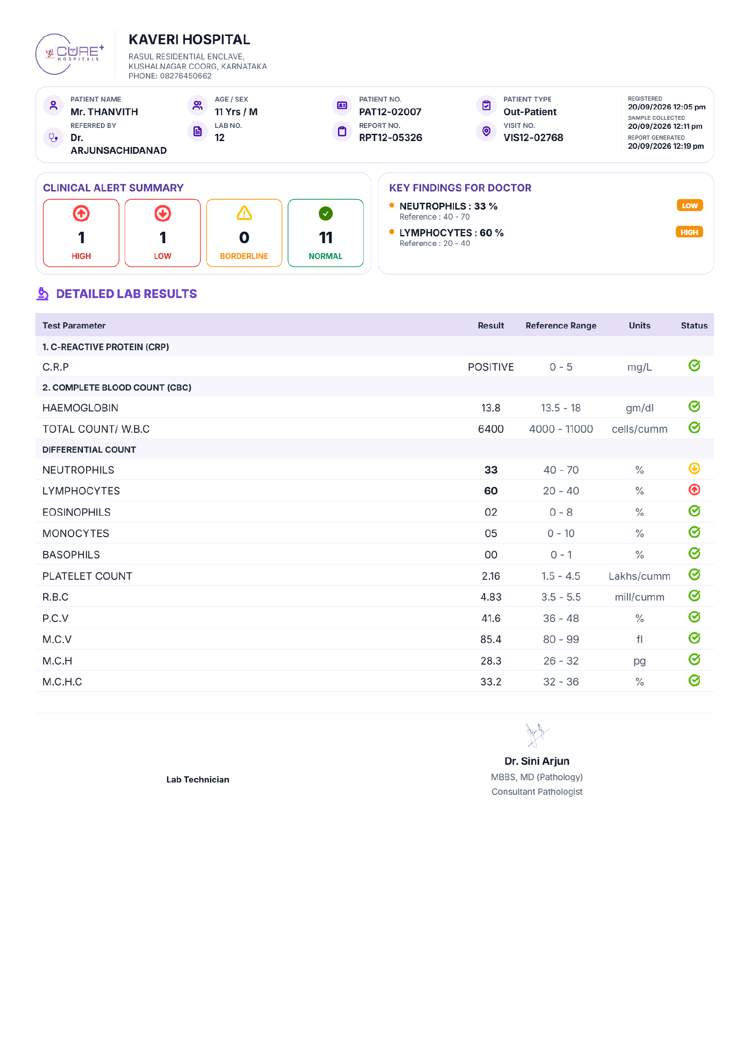
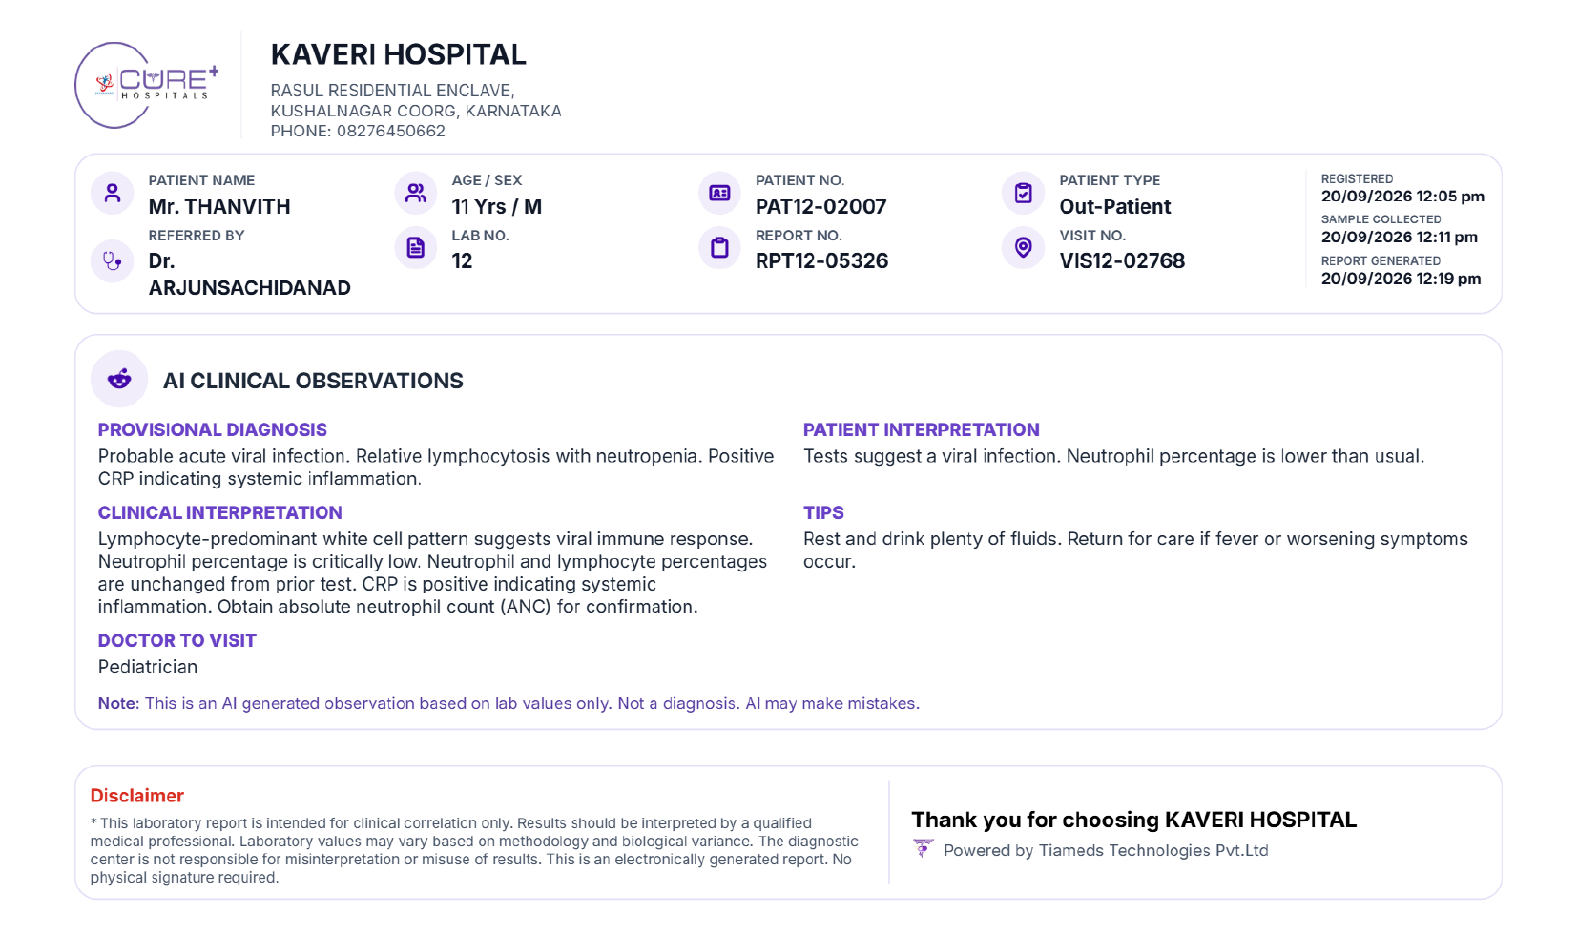
LAB REPORT • AI INSIGHTS
A Smarter Lab Report
🤖
AI CLINICAL OBSERVATIONS
Provisional Diagnosis
Probable acute viral infection — relative lymphocytosis with neutropenia and a positive CRP, indicating systemic inflammation.
Doctor to Visit: Pediatrician
Patient Interpretation
Tests suggest a viral infection. Neutrophil percentage is lower than usual, and lymphocyte percentage is higher than usual.
Tips: Rest and drink plenty of fluids. Return for care if fever or symptoms worsen.
NOTE : Future Enhancement: Location-based doctor discovery and appointment booking with relevant specialists.
TiaMeds Technologies Pvt. Ltd.

Slide 11



“THE PROBLEM”
Pharma Commerce Runs on Manual Trust
Manufacturers, distributors, hospitals and pharmacies operate in silos — with no shared digital backbone.
Fragmented Ecosystem
Manual Procurement
No central platform connects the multi-layered supply chain — manufacturers to pharmacies operate in silos.
Phone calls, WhatsApp orders, email quotations, and paper drug licenses remain the norm.
THE COST OF STAYING MANUAL
Medicines at Risk of Being Substandard
Procurement Delays (Manual Workflows)
Fragmented Inventory Data
Restricted Market Reach
DIGITAL HEALTHCARE CANNOT SUCCEED WITHOUT TRUSTED DIGITAL COMMERCE
India needs compliance-first, intelligent, trusted digital infrastructure for pharmaceutical commerce — TiaMeds Marketplace(PHARMA MARKETPLACE)
TiaMeds Technologies Pvt. Ltd.
7

Slide 12



MARKET CONTEXT
The Journey Medicine Takes Today
A multi-tier, largely manual supply chain — with friction, paperwork, and blind spots at every handoff.
Manufacturer
C&F Agent / Super-Stockist
Distributor / Wholesaler
Hospital / Retail Pharmacy
Patient
Production & Batch Release
Regional Bulk Storage
City-Level Distribution
Last-Mile Dispensing
Point of Care
FRICTION AT EVERY HANDOFF
Phone & Email Purchase Orders
Paper Invoices & Manual Entry
No Batch/Expiry Visibility
Delayed Payment Reconciliation
Every handoff above is a point of friction today — manual, paper-based, and disconnected.
TiaMeds Marketplace digitizes this entire journey end-to-end — verified sellers, compliant transactions, and full traceability from manufacturer to patient.
TiaMeds Technologies Pvt. Ltd.
8

Slide 13



THE SOLUTION
An AI-Powered B2B Pharma Marketplace
Right medicine. Right source. Right price. Every seller verified, every transaction traceable.
SELLERS
COMPLIANCE
CHECK
TIAMEDS
MARKETPLACE
BUYERS
License, batch & expiry verification (TiaMeds Admin)
Product Registry · AI Recommendations
Hospitals · Pharmacies · Clinics
Manufacturers · Distributors · Wholesalers
END-TO-END TRACEABILITY — every order, batch & payment auditable across the full journey
HOW WE DELIVER VALUE
B2B
25%
Quality
20%
100%
Scalable
Marketplace Access
Faster Procurement
& Safety Assured
Expense reduction
Trusted Ecosystem
Integrated Architecture
TiaMeds Technologies Pvt. Ltd.
9

Slide 14
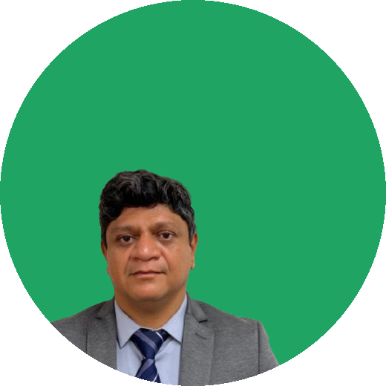







THE TEAM
Healthcare Professionals, Not Outsiders
Built by Medical Operators & Healthcare Professionals
Abhinandan S. Rao
Dr. Sini Arjun
Ram H. H.
Subject Matter Expert
Medical Resource Expert
Delivery owner
B.Sc. (BtBM), MBA-HA. Healthcare professional with extensive experience across IT and pharma industries.
25+ years in Oncopathology, healthcare management, and clinical leadership across hospital institutions.
SUPPORTED BY DEDICATED FUNCTIONAL TEAMS
Software Mysuru
Software Bengaluru
Learning & Development
Public Relations
Digital Marketing
TiaMeds Technologies Pvt. Ltd.
11

Slide 15


IMPACT
Why TiaMeds Matters
Technology becomes a strategic asset supporting multiple businesses.
Internal deployment provides a real-world environment for product validation and refinement.
Integrated data flows can reduce fragmentation between laboratory, pharmacy and hospital operations.
Marketplace infrastructure can connect demand and supply across the pharmaceutical ecosystem.
Platform architecture creates opportunities for scalable digital services and partnerships.
TiaMeds Technologies Pvt. Ltd.
19

